Slide 1
SVCT New York City Arts Journey
July 16 - July 20, 2018

Slide 2
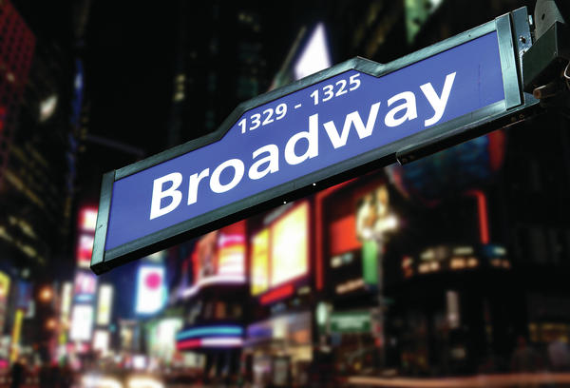
Highlights of What We’ll See
Metropolitan Museum of Art
Radio City Music Hall
Many Broadway Shows!
Chinatown

Slide 3
Tour Itinerary
Day 1 Hello New York
Meet your Tour Director
Midtown Walking Tour: Rockefeller Center, St. Patrick's Cathedral, Times Square, Grand Central Terminal
Dinner
Top of the Rock visit
Day 2 Downtown Manhattan
Breakfast
Broadway workshop
Lower Manhattan guided sightseeing tour: Trinity Church, Wall Street, 9/11 Memorial visit, Chinatown, Little Italy
SoHo gallery walk
Dinner
Broadway show
the experience is everything

Slide 4
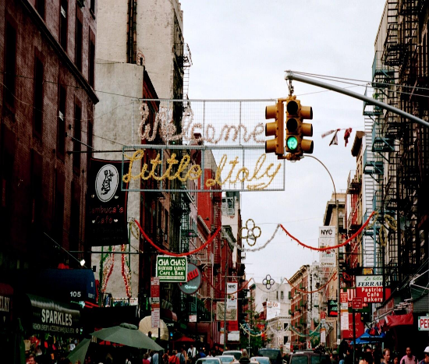
Tour Itinerary
Day 3 New York City
Breakfast
Radio City Music Hall guided tour
MoMA visit
Dinner
Broadway show
Day 4 Uptown Manhattan
Breakfast
Metropolitan Museum of Art visit
Central Park walking tour: Cherry Hill, Strawberry Fields, Belvedere Castle, Delacorte Theater
Dinner
Broadway show
Day 5 End Tour
Breakfast
Ferry boat to Ellis Island & Statue of Liberty
Travel home
the experience is everything
Notes:
Day 5 Start New York ExtensionBreakfast
Lincoln Center for the Performing Arts guided visit
Fashion Institute of Technology Tour
NBC Studios guided visit
Dinner
Day 6 New York CityBreakfast
Travel home

Slide 5
What’s Included?
Round-trip transportation
4 overnight stays in hotels with private bathrooms
Breakfast daily (except arrival day)
Dinner daily (except departure day)
Full-time services of a professional Tour Director
Guided sightseeing tours and city walks as per itinerary
Visits to select attractions as per itinerary
Overnight security chaperone
On-tour tipping
Tour Diary™
Note: Tour cost does not include airline-imposed baggage fees, or fees for any required passport or visa. Please visit our Fees FAQ page for a full list of items that may not be included in the cost of your tour.
the experience is everything

Slide 6
Pricing Details
See detailed pricing at: http://www.explorica.com/Mandel-8899
Total Student Cost: $1,849*
Total Adult Cost: $2,074*
Adults (23+)
*Sign up by October 12th, 2017 and use the scholarship code Theatre75 at time of enrollment to receive this discounted price!
*Have you traveled with Explorica before? Then take an additional $50 off the tour cost!
the experience is everything

Slide 7
Payment Options
Automatic Monthly Payment Plans
$50 deposit and any selected travel protection costs at registration.
Balance is divided into equal monthly payments.
All payments billed automatically to credit card or checking account.
Manual Payment Plan – 3 step
Payments are divided into three timed steps:
$99 deposit and any selected travel protection costs at registration.
$300 due 30 days later
Full balance is due 95 days prior to departure.
Manual Payments by check or credit card.
Pay in Full
Entire balance paid upon registration
Payments by check or credit card
the experience is everything

Slide 8
Enrolling Online is Easy
Visit www.explorica.com
Find the “Students: Sign Up” button and then click to go to the next page
the experience is everything

Slide 9
Enter the Tour Center ID
Mandel-8899
the experience is everything

Slide 10
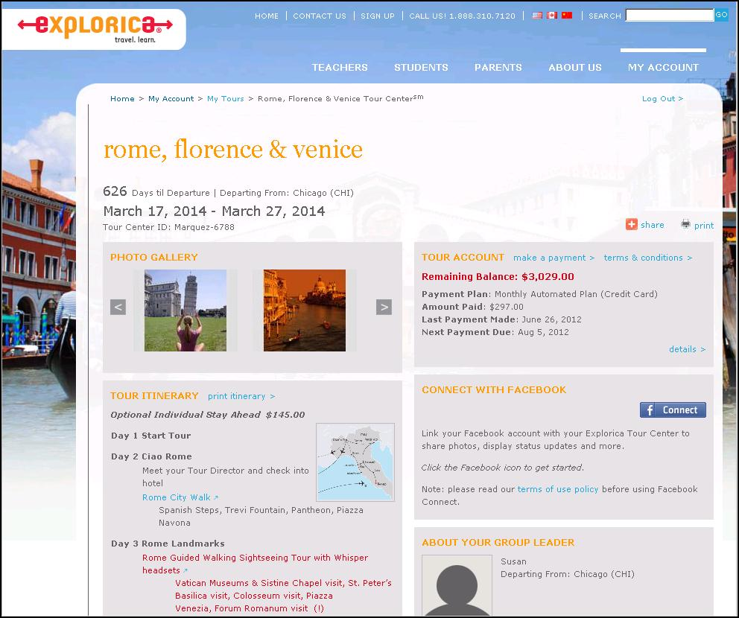
Easy Online Payments
the experience is everything
Notes:
Travelers get their own individual Explorica accounts with username and passwords. The search engine let’s you find quick and easy answers to your questions. Everything you could need is online.

Slide 11
Contact Explorica
Email
info@explorica.com
Mail
Explorica, Inc. 145 Tremont St., Fl. 6 Boston, MA 02111
Fax
1.888.310.7088
Phone
1.888.310.7121
the experience is everything

Slide 12
Questions?

